Slide 1
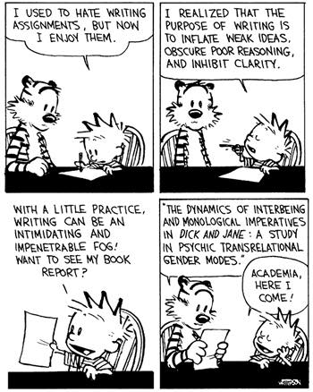
(Grant) Proposal Writing
Dr. Danine Farquharson
daninef@mun.ca

Slide 2
What Research Proposals Must Do
Provide a detailed description of your proposed research
Be as specific as possible.
Provide background information to position your proposed research within the context of the current knowledge in the field.
State the objectives and thesis, outline the theoretical approach to be taken (citing literature pertinent to the proposal), and
State the methods and procedures to be used.
State the significance of the proposed research to your field and beyond.

Slide 3

What: description and
background
Who: literature review
How: objectives, thesis, methodology, knowledge translation
Why: significance for
your field and for the
general public

Slide 4
Know Your Audience
Readers will be intelligent
Readers will be overworked (they’re reading tons of other proposals)
Readers have short deadlines
Readers may not be in your exact discipline
Readers are experienced proposal writers

Slide 5
Therefore …
Ensure your writing is appropriate to a general and intelligent audience
Ensure you are clear, direct, and use headers to highlight content
Ensure you make it easy for readers to see and absorb your main points
Ensure you AVOID jargon and discipline specific diction
Ensure your proposal addresses all the required information

Slide 6

Language Matters

Slide 7
First…
Have a good idea.

Slide 8
What’s a ‘good’ idea?
Is the problem significant?
Does your research directly address the problem?
How will knowledge be advanced (theory)?
Is it INNOVATIVE?
Does it build upon or expand our knowledge base?
Is it capable of making a difference?
Is it UNDERSTANDABLE?

Slide 9
What’s a ‘good’ title?
Clear and descriptive
  Don’t use jargon/buzz words here
  Make sure it fits the subject matter
  It needs to be short and to the point: aim for no more than 6 words in your title
  It should telegraph to readers your main ideas

Slide 10
Organize the Proposal
Use this order of section headings:
Context
  background and review of literature (with citations)
Objectives
  goals/Research questions/thesis (be as specific as possible)
Theoretical Framework/Methodology/Approach
Significance
  Contributions to knowledge and significance to the field and beyond (outcomes, impacts)

Slide 11
Use all resources
Ask someone who does not know your area to read your proposal. Ask them if they understand
  What you are proposing to do?
  How you are proposing to do it?
  Why you are proposing to do it?
Get feedback on clarity from multiple sources

Slide 12
Proposal writing: Do’s
Be captivating: start with something that will engage the reader
Know your audience
Be clear and focussed
Address fundamental research challenges
Discuss your quality contributions, when appropriate

Slide 13
Proposal Writing: Do’s
Discuss impact of your research (does it build upon or expand our knowledge? Is it capable of making a difference? i.e. breadth and scope, advancement of knowledge, betterment of society, etc.,
Become a student of grant; research what the sponsors strategic plan, research their mandate, know their mission statement, learn the grant specific guidelines, understand the eligibility criteria, and research previously funded projects.

Slide 14
Proposal Writing: Do’s
Organize the attachments using the proper formatting standards
Use section headings outlined in the instructions.
All Tri-Council grant applications come with “presentation” standards that lay out margins, font, font size. Follow these EXACTLY
Only ever submit your best work – do not do toss in a proposal to see how you would do…

Slide 15
Proposal Writing: Don’ts
Never embellish the significance or feasibility of your research. Be honest. Be specific. Experienced grant readers will detect when your descriptions are vague or exaggerated. If you use qualifiers such as “significant,” “excellent,” or “extremely,” justify them with examples.
Do not submit proposals full of errors. Always thoroughly proofread your proposal.

Slide 16
Proposal Writing: Don’ts
Do not get discouraged if your proposal is not accepted by the funding source the first time. Reviewer’s comments are often available to help you strengthen your proposal for resubmission. Often you can make some minor revisions and resubmit successfully the next time around.

Slide 17
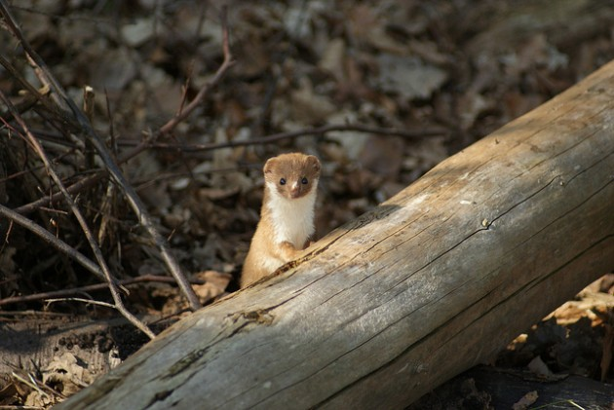
Don’t use weasel words

Slide 18
Passive Language
AVOID: may, might, could, would, seem, possibly and probably
Those words weaken your argument and make it sound like your study is not well designed enough to result in a definitive answer to your research question.
AVOID writing a proposal laced with uncertainties. Trust yourself to declare your hypotheses in clear and definitive terms.
AVOID future or past tense: always use present tense verbs

Slide 19
Common Errors
Lack of focus or coherence
Repetitiveness
Failure to cite important & relevant work in the area
Citing too many irrelevant articles
Spelling or grammatical mistakes
Too much detail on minor issues; too little detail on major issues
Research contributions not properly highlighted (too modest)
Impact / importance of research not explained

